Slide 1
Harry Potter Trivia
General Assembly WDI Project 1
19th September, 2017
Daniela Aguirre

Slide 2
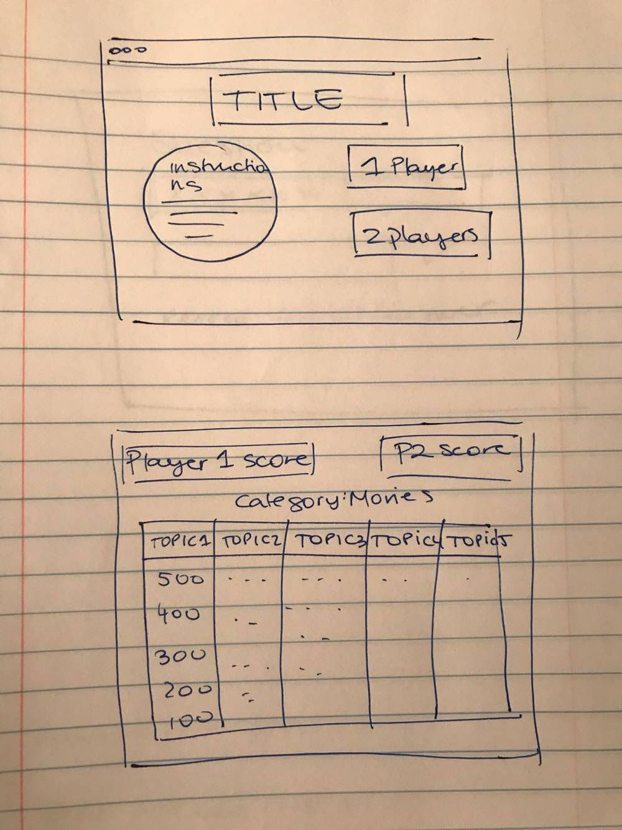
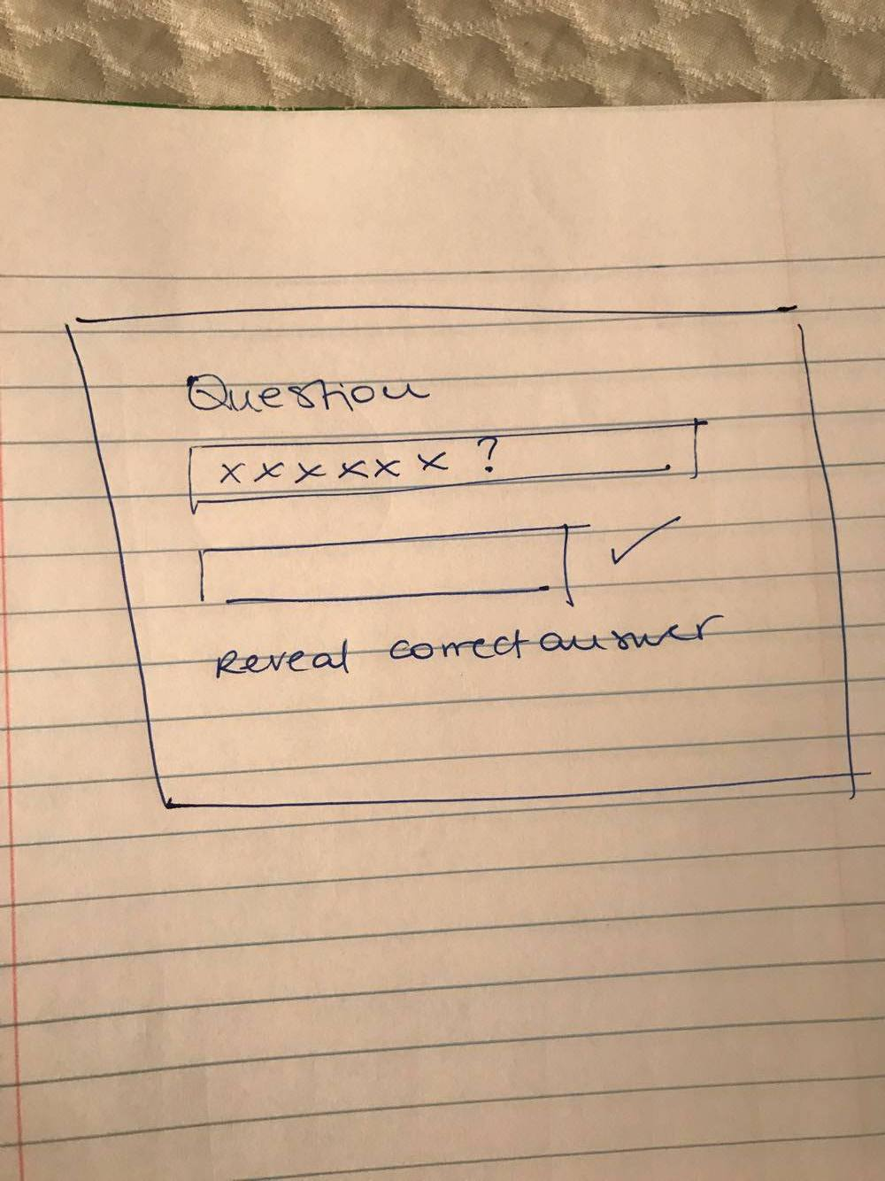
Wireframes

Slide 3
about
Harry Potter Trivia
2 player mode
Goal: Obtain the highest score by the end of the game.
Instructions:
Select one of the five Harry Potter topic's and within it a level of difficulty
The program will prompt a question, if answered correctly, the number of points stated on the block will be awarded to the player.
If answered incorrectly, no points will be given to the player and players will switch turns.
Game Over: Game can end once all of the questions have been responded, or by pressing on the "End Game Button" if the players decide to end it.

Slide 4
features
Landing page with an accordion header to display the instructions
Pop up to enter player's names that then display throughout the game
A 2 player table that keeps track of both players’ scores
Change in appearance after each cell has been clicked
Text announcing each player's turn
End button that allows the player's to end the game before all cells are clicked
End function that ends the game once all cells are clicked
Relatively responsive design

Slide 5
Technology
This game was built with the following core web technologies:
HTML
CSS
Javascript
JQuery

Slide 6
constraints
Time constraints

Slide 7
Learning Experience
Leave the styling for last!
Think through the logic and the different functions I want to have before starting to build the game
Git add and commit more often
Comment code, not delete

Slide 8
Improvement opportunities
Build a Player 1 Mode
Time limit on the 1 player mode so he can compete against himself
Add relevant animations
Let user pick a character that represents him throughout the game
Store the score in the computer for when future users play, they know who has the top scores in the game
Add different categories, more questions
Track scores across games (even if the page is reloaded)
Format the buttons
Make it responsive for other devices

Slide 9
Demo
publisher-welders-45302.bitballoon.com

